Slide 1
Cultural Navigation
Analysis for Refugee Empowerment Project​
2024​

Slide 2
Introduction
Clear graphic representation of the data.
Identifying the Key Factors that Influence the Pathway from Refugee to Citizen
Understanding the correlation between various factors and outcomes is crucial in determining the important features that enable a refugee to become a citizen.
The following insights were derived after thorough analysis of the data.

Slide 3

Presenter Introduction
Biynah Dayok

Slide 4
Individuals’ Work
(1) what you did and why;
After graphically representing and analyzing the data, I identified an area for improvement in the number of refugees obtaining citizenship. Additionally, I examined the correlation between various actions/variables and their corresponding outcomes.
(2) what you found (as interesting);
The fact that age has the highest impact on a refugee becoming a citizen.
(3) what your analysis contributes to
My analysis unveils key strategies to boost the number of refugees achieving citizenship, paving the way for a more inclusive future.

Slide 5
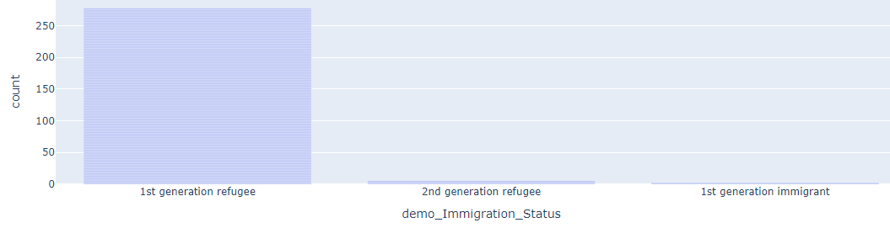
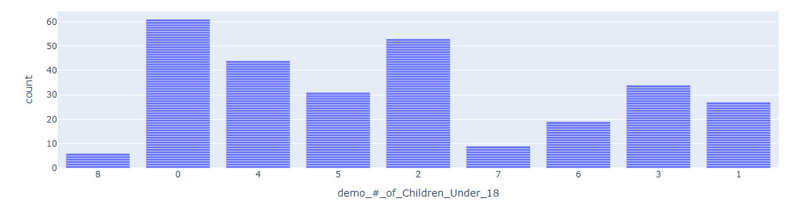
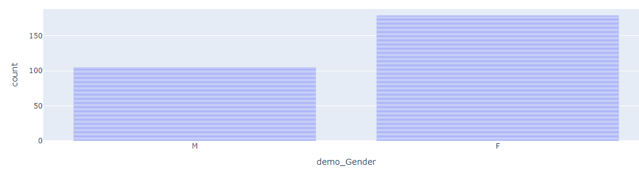
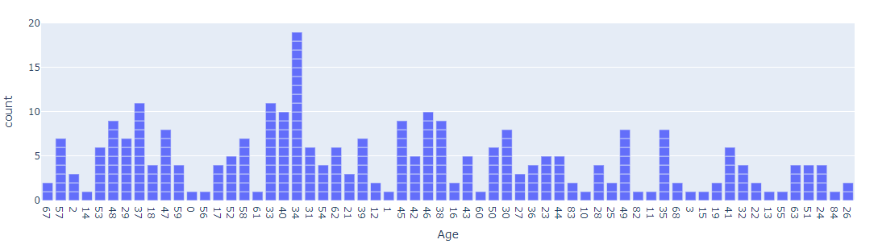
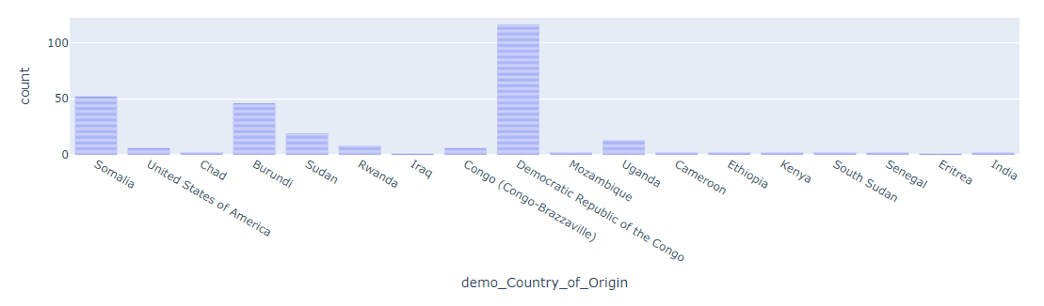
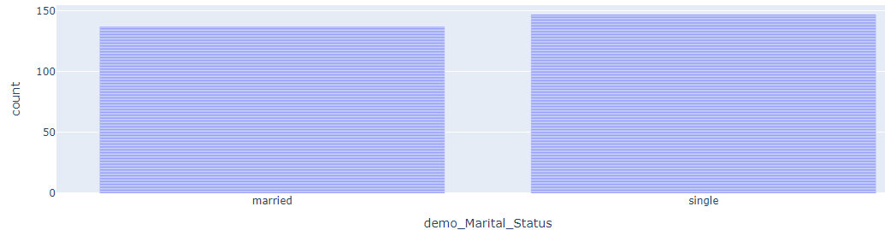
Graphical representation of various refugee features

Slide 6
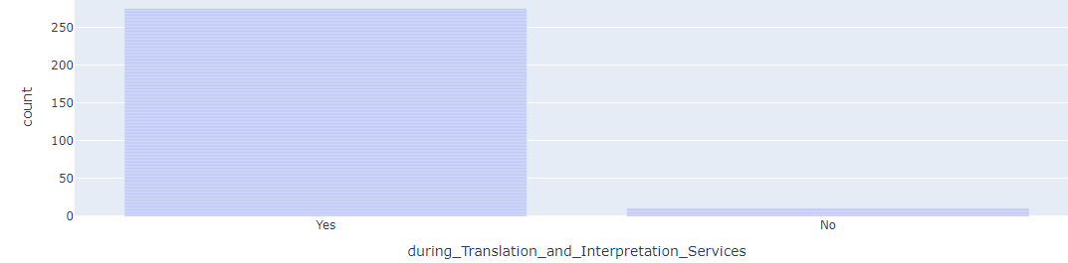
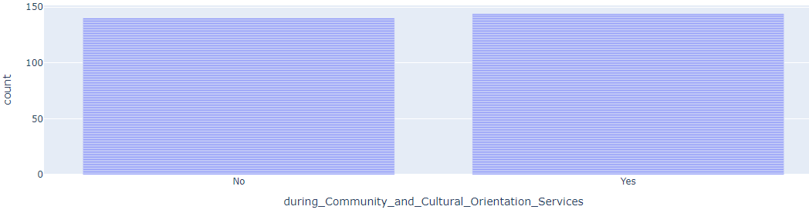
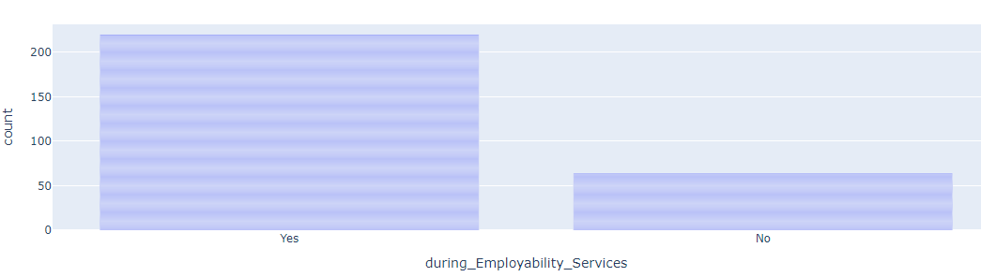
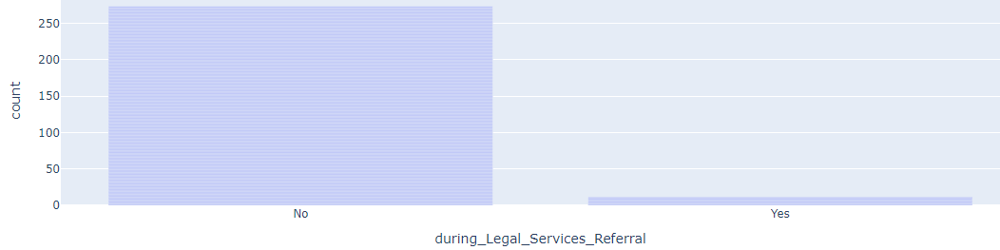
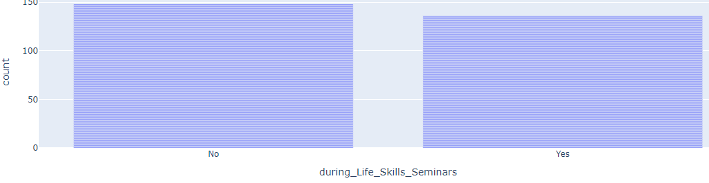
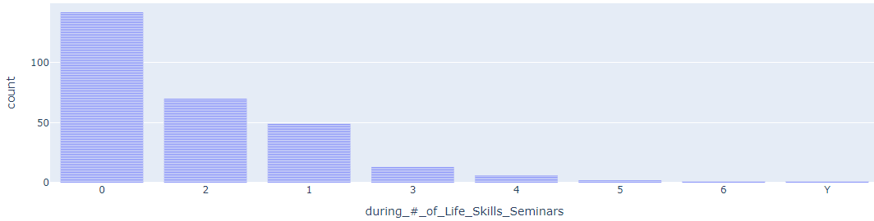
Graphical representation of refugee participation in various programs

Slide 7
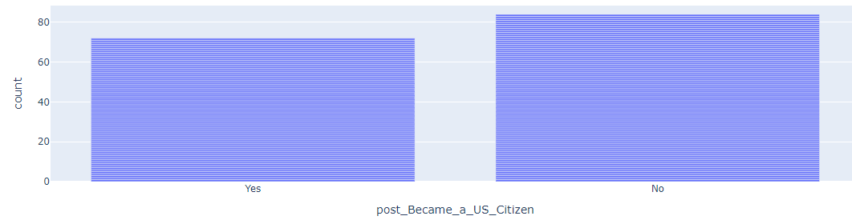
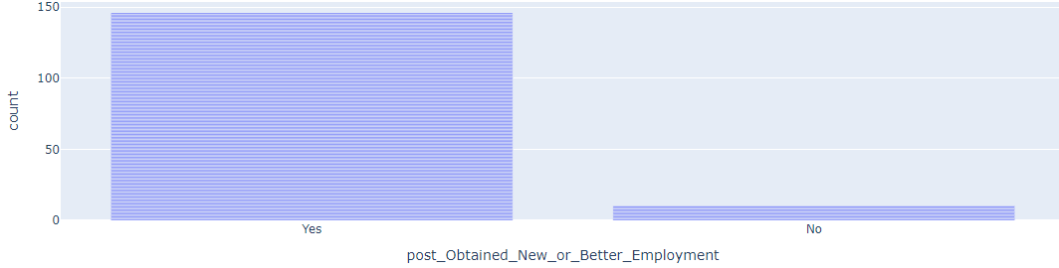
Outcomes of refugees after the program
1. The age distribution is concentrated between 20 and 65 years, with a mean age of 42. Notably, 7% of the population is 34 years old, making it the most common age.
2. Participants come from 14 countries, with the majority (approximately 45%) being from the Democratic Republic of Congo.
3. The majority of the immigrants are female, comprising 62% of the total.
4. Approximately 51% of the immigrants are married.
5. About 23% of the participants do not have children, while those with 7. children have an average of three.
6. Nearly 99% of the immigrants are first-generation immigrants.
7. 1.97% percent of immigrants participated in Translation and Interpretation Services.
8. We see 50% percent participation in during Community and Cultural Orientation Services.
9. We see an 80% participation in Employability Services.
10. We see a poor 3% participation in Legal Services Referral.
11. We see a 48% participation in Life Skills Seminars.
12. Additionally, we observe the number of seminars attended by participants. We can see that most participants did not attend a single life skill seminar.

Slide 8
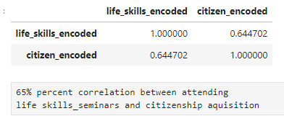
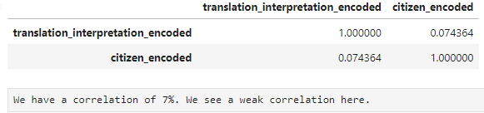
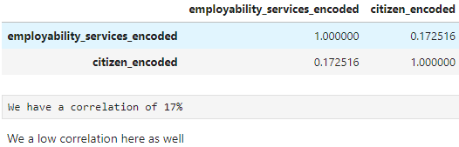
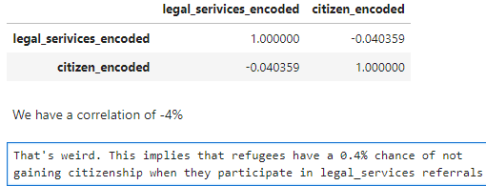
Notable correlations

Slide 9
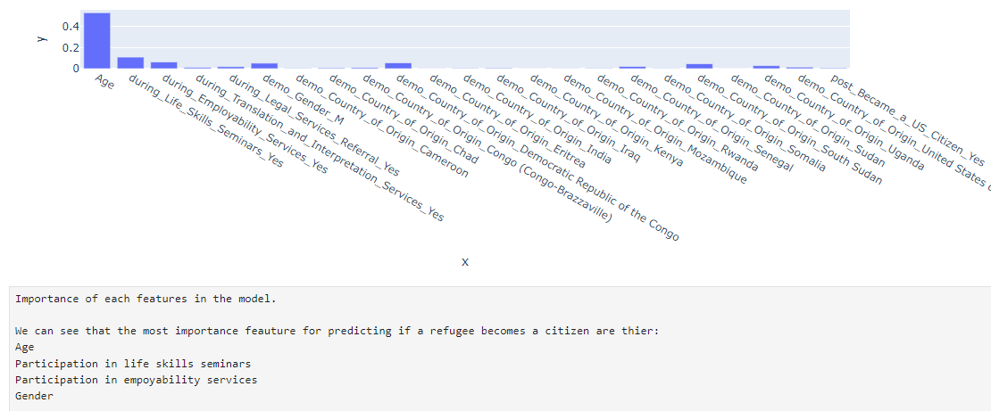

Slide 10
Wrapup
The more life skills, employability and translation services a refugee under goes, the more his/her chances of obtaining a citizenship increases.
The more he participates in legal services, the lesser his/her chances of becoming a citizen
The following have the highest impact on a refugee becoming a citizen. They could be optimized for better performance in becoming citizens:
Age(People around the age of 42)
Participation in life skills seminars
Participation in employability services
Based on the data, I have been able to derive the following insights to optimize the process of refugees attaining citizenship.

